Slide 1
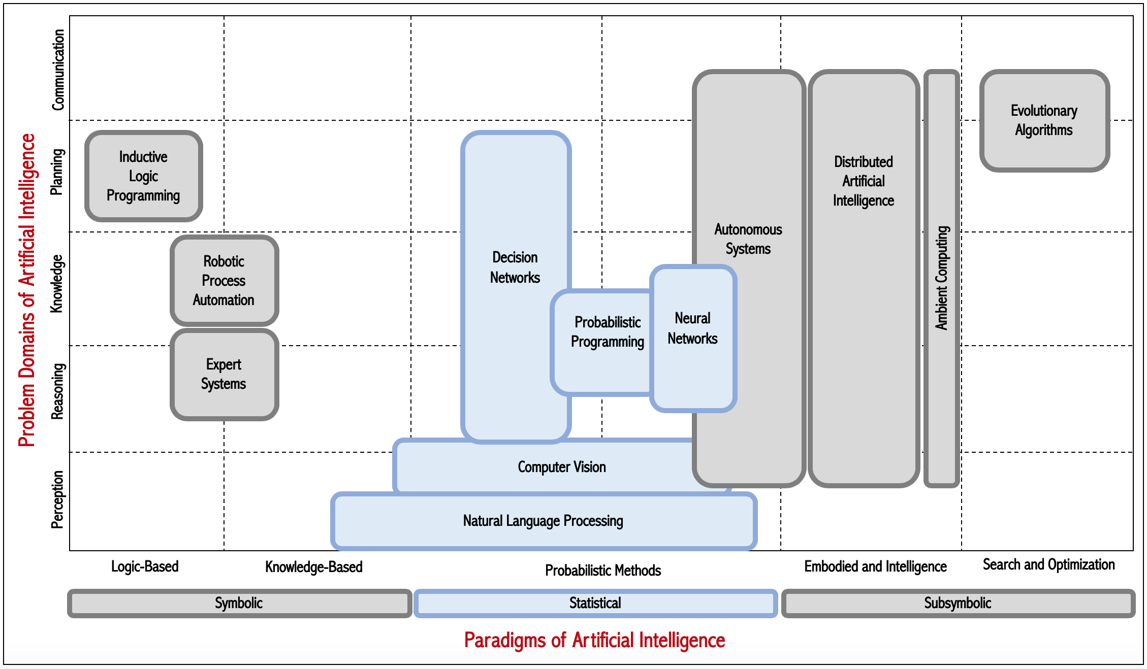
Bayesian
Networks
Bayesian Program Synthesis
Deep Learning | General Adversarial Networks
Fuzzy systems
Activities Recognition | Image Recognition | Machine Vision
Machine Translation | Natural Language Understanding | Natural Language Generation
Probabilistic
Methods
Supervised | Unsupervised | Reinforcement
Machine Learning
https://www.mdpi.com/1996-1073/13/6/1473/htm
https://www.forbes.com/sites/cognitiveworld/2018/08/22/ai-knowledge-map-how-to-classify-ai-technologies/?sh=3bd0de1c7773

Slide 2
